Slide 1
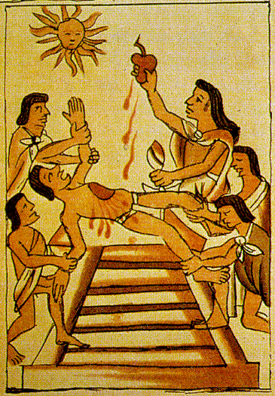
AZTEC
Notes:
<number>
Human Sacrifice, Codex

Slide 2
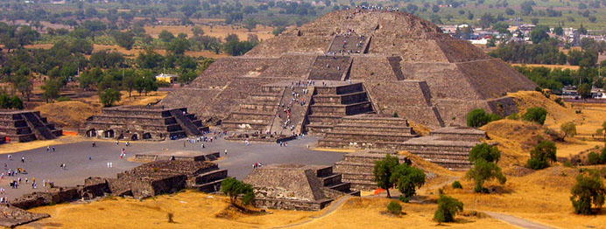
teotihuacan

Slide 3
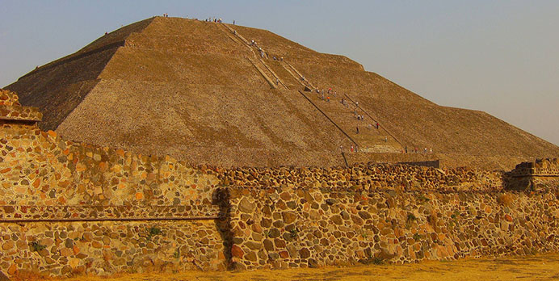
teotihuacan

Slide 4
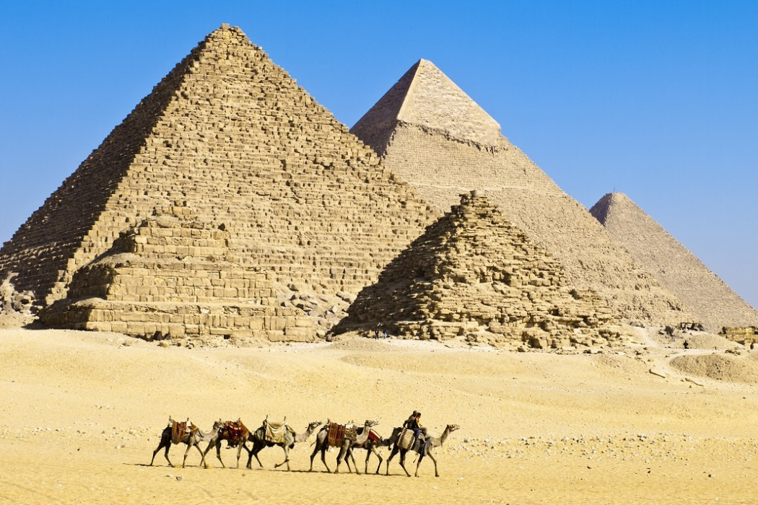
egypt

Slide 5
egypt

Slide 6
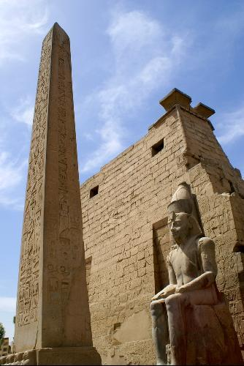
egypt

Slide 7
egypt

Slide 8
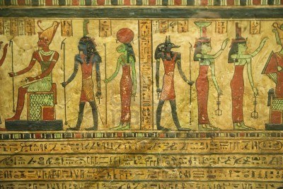
egypt

Slide 9
egypt

Slide 10
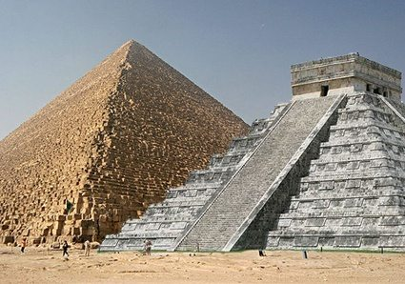

Slide 11
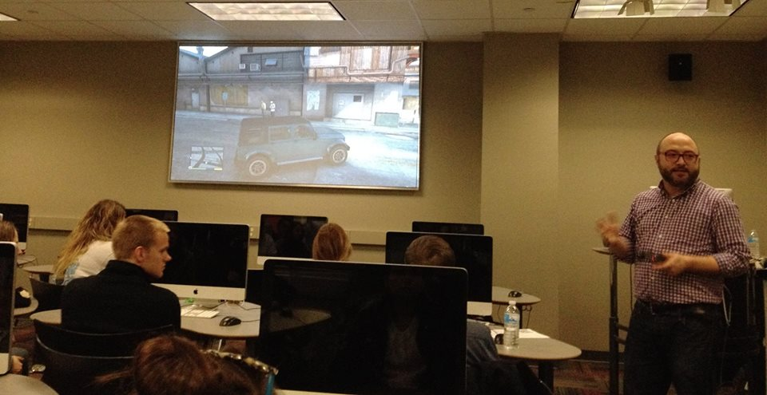
The article refers to stereotypical Latin American characters including “el bandido, the harlot, the male buffoon, the female clown, the Latin lover, the dark lady, the drug runner, and the inner-city gang member.” (178)
Have you encountered any of these characters, or other representations of Latin Americans, in video games? Did these characters reinforce conventional views, or invert stereotypes? How do they relate to the reading?
Why do game designers use cultural stereotypes? Are there any good or useful reasons to use such stereotypes? What negative—or positive—effects can these stereotypes have? (179-181)
Have you played any of the games in the three main categories mentioned in the article? Did you see the game in the same way as the article? What other games set in Latin America could be added to one of these categories?
Contras (Call of Duty, the Tom Clancy games, Mercenaries 2, Call of Juarez) (181-182)
Tomb Raiders (Pitfall!, Tomb Raider, Uncharted, Age of Empires) (182-183)
Luchadores (Just Cause, Lucha Libre AAA, Red Dead Redemption) (183-184)
Phillip Penix-Tadsen “Latin American Ludology: Why We Should Take Video Games Seriously (and When We Shouldn’t)”

Slide 13
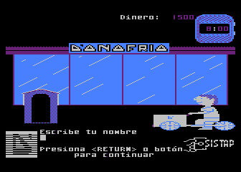
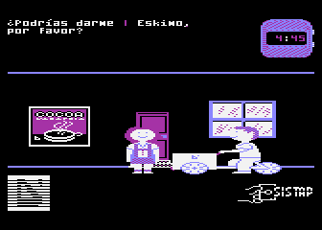
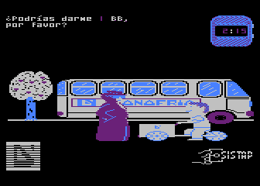
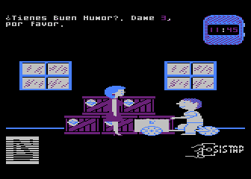

Slide 14
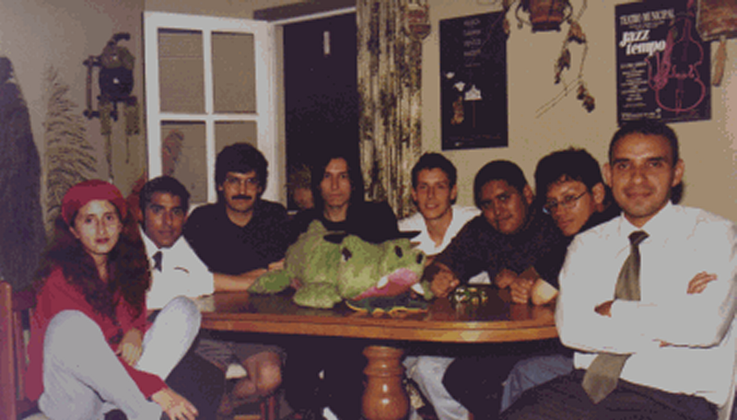
TEG The King of Peru 2 development team

Slide 15
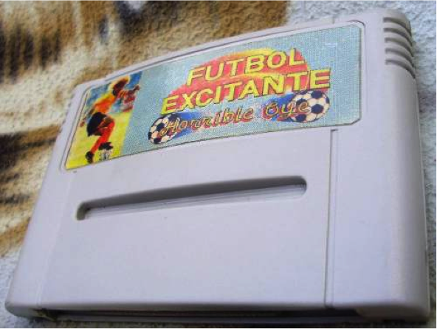
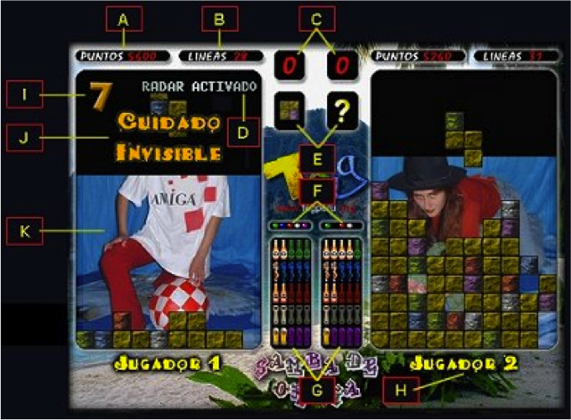
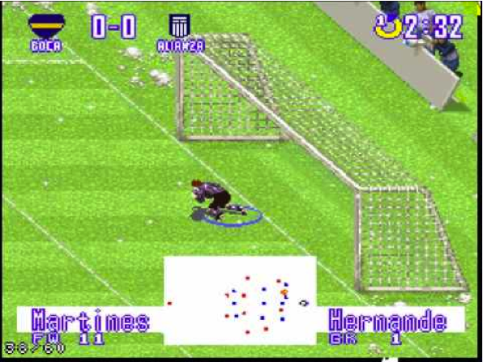

Slide 16
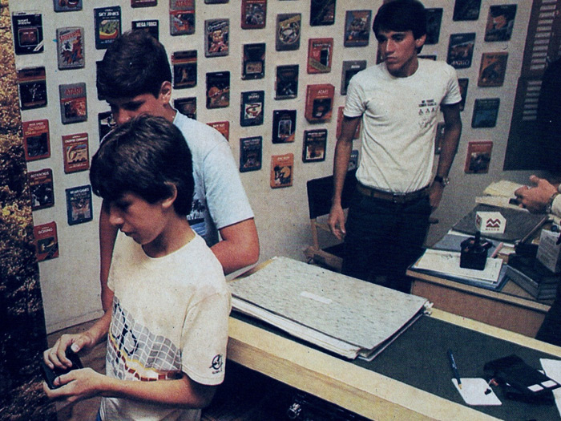
Brazilian Locadora focusing on Atari 2600, 1983
Notes:
1983, Brazilian “locadora” focused on Atari 2600
http://noticias.r7.com/tecnologia-e-ciencia/fotos/veja-imagens-dos-primeiros-videogames-no-brasil-20120823-9.html
<number>

Slide 17
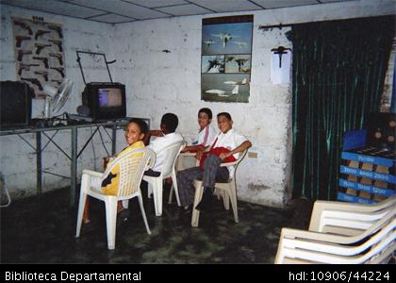
Cali, Colombia
2005

Slide 18
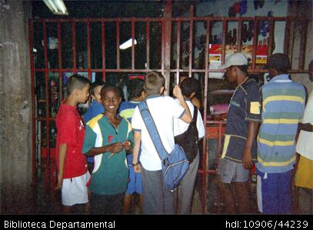
Cali, Colombia
2005

Slide 19

Does nation still matter? How have Peru’s politics and economy affected the development of the national game industry? (35-40, 54, 61-62)
Was TEG [Twin Eagles Group] a software piracy company, a club of amateur software modifiers, or something else? Who or what benefitted from TEG’s software modification? Who or what suffered? (53-61)
What are some effects of the cybercafé on the circulation of video games in Latin America? (61-64)
In what ways does Bamtang Games represent a new era for the Peruvian game industry? (67-70)
How is Marisca’s academic research different from Luis Wong’s Polygon article about TEG? How is it similar?
Eduardo Marisca “Reconstructing a Technological History”

Slide 20


Slide 21
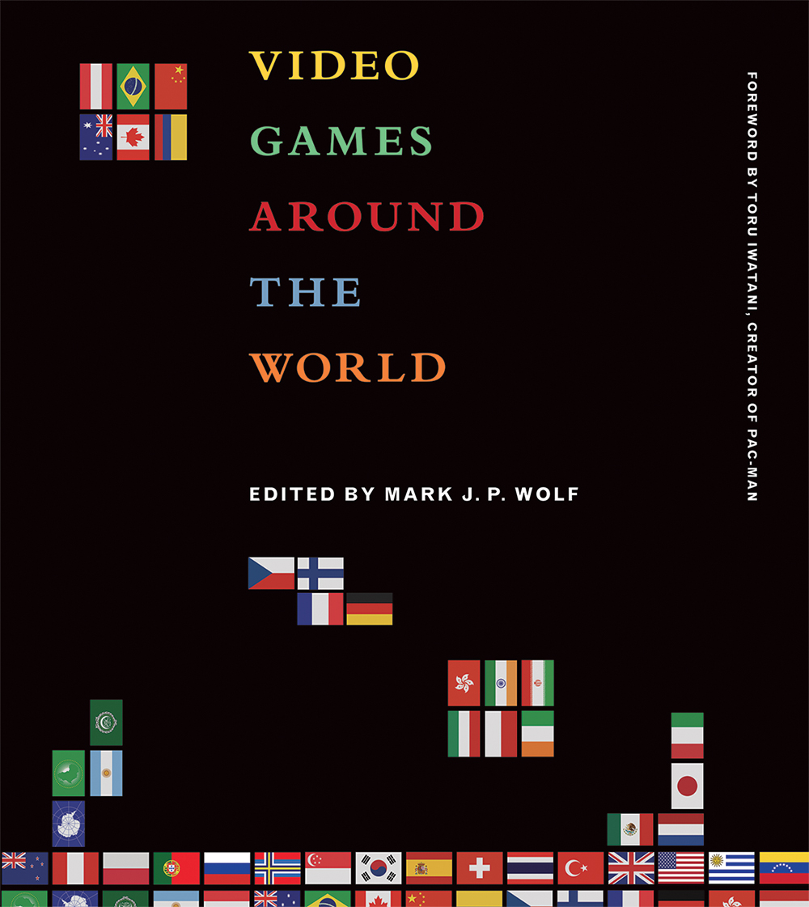
Name the country you read about, and describe the role of…
Historic hardware / platforms
Historic software / games / genres
Local vs. Global aspects of game design and play
National politics and economics
Player and industry demographics
sex, race, age, economic class, etc.
Support networks for game development and play
higher education programs, industry organizations, industry or gaming events, game magazines, etc.
Related topics
art, music, edutainment, etc.
Video Games Around the World
Edited by Mark J.P. Wolf

Slide 22
First: Divide into Groups
Mexico | Uruguay & Venezuela
Brazil
Argentina | Colombia & Peru
Front of classroom
Video Games Around the World
Edited by Mark J.P. Wolf

Slide 23
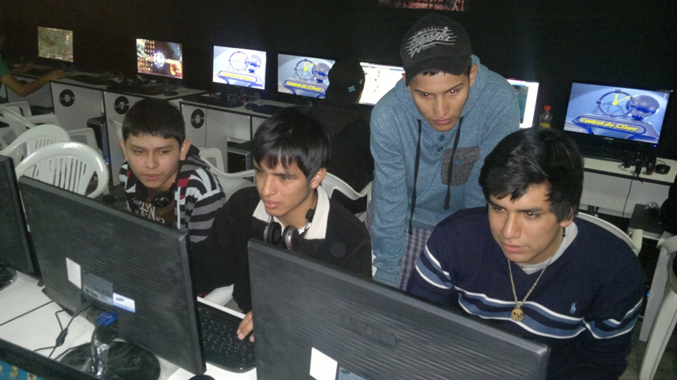
Jerjes Loayza
Ludic Solidarity and Sociality:
The Impact of Dota 2 on Lima’s Youth
2019
What is one connection between this reading and the other course materials (Marisca, Wong, etc.)?
What is one of the effects of Dota 2 on its players, according to Loayza? What is one of the concrete benefits the members of Last Resort gain from their experience?
For players in Lima, how did the Dota experience when it moved from the living room to the cybercafé?
What is one way Peru’s economy and politics affect the members of Last Resort?

Slide 25
ACADEMIC TONE / REGISTER
A1. According to Fernández-Vara, are game reviews good or bad for helping understand video games? Why?
A1. Fernández-Vara states within the opening of her first chapter that video game reviews are generally poor tools for players to better understand video games, as they invite their readers to look at the game subjectively and look for highlighted features within the game’s structure over the collective aspects that make up the identity of the game. Because video game journalism is typically the first media platform fans can reach games on, the writing becomes “subject to a series of economic pressures that condition its content” (Fernández-Vara 3). The writing, now laden with marketable features, serves to encourage prospective buyers and browsers of the article to buy the game based off of a very limited and biased understanding of it.
HOMEWORK I

Slide 26
ANALYZING PERSONAL EXPERIENCE THROUGH COURSE MATERIALS
D1. In your experience, are video games just as socially marginalized today? Or have games emerged from the shadows?
D1 Looking back I believe that videogames are becoming more and more socially acceptable. Originally when playing these games, the goal was “beating the machine” (38). You were not defeating an equal, you were defeating a machine. On top of that, winning did not reap material rewords, but awarded a “symbolic reward” (38). This made people that played video games seem strange for people that were not familiar with the gaming experience. I believe this is where the “gamer” stigma arose.
Recently playing video games has become more socially acceptable than ever before. Celebrities are playing, people show their face while they play (streamers). You see video games in the news and on all forms of social media. I believe this is due to how gaming has broadened to player vs player encounters where players (equals) can compete through the medium a game. Today instead of competing for high scores, players compete for material rewords. Even though not everyone competes for material rewards, the fact that these opportunities exist combined with the increased social aspects, video games have emerged from the shadows!
HOMEWORK I

Slide 27
SPECIFIC REFERENCE TO COURSE MATERIALS
A1. Are game reviews good or bad for helping understand video games? Why?
A1. Fernandez-Vara wrote that video game reviews are bad for helping to understand video games. One reason she gives is that “reviews are often skewed by economic interests” (3). Although this is changing, she also says there needs to be more game analysis outside of major media sites. Often, she calls for academics to provide nuanced game analyses that go deeper than “the quality of graphics or the difficulty curve” (4). Instead, the analysis of a game should talk about its user interface or what differences in the mechanics of different characters might suggest. This type of analysis, she says, can be done by anyone already involved in the arts or humanities, but what she really wants is more diversity in the types of people engaging with the games, “from the casual player to the ludophile” (5).
HOMEWORK I

Slide 28
SPECIFIC REFERENCE TO COURSE MATERIALS
C2. Do you think the nation is still significant to the way video games circulate?
C2.) I believe the nation is still significant to the way video games circulate. Some countries have a lack of presence of popular video game companies such as Nintendo, Blizzard, Sony, Ubisoft, etc. and have a difficult time obtaining the video game consoles and playing the games legitimately. We also have to keep in mind of the “political and cultural thickness of differences in ethnicity, sexuality, and locality” (Martin-Barbero 41). Countries such as Brazil, Australia, and Saudi Arabia ban video games with violent content and criminal activity that, for example, exists within the “Grand Theft Auto” series. Germany censors or bans games with Nazi symbols or imagery, such as the “Wolfenstein” series, regardless if the Nazis are considered antagonists. Censorship and bans in a nation due to how a country’s government can control what their citizens can be exposed to, and the video game company’s limited availability in certain countries hinder the way video games circulate.
HOMEWORK I

Slide 29
SUBTLETY, NUANCE AND DETAIL
D1. In your experience, are video games just as socially marginalized today? Or have games emerged from the shadows?
D1. Sarlo compares a video game arcade to a casino to highlight their seediness, with artificial lighting, constant digital sounds, a lack of women, and the repetition and concentration spent on single machines (36-37). These days, the stigma against video games has largely disappeared, partially because the location of gaming has changed. There is still a particular stereotype of the male gamer alone in his basement, in complete darkness except for the light of the screen, isolated and focused in the same way Sarlo observed in arcades. However, this stereotype has been broken enough times by the popularization of phone and social media gaming, which changes the scene yet again from a dark hovel to a crowded bus or lunch table, in order to bring games from the social margins to the center of culture. Additionally, Sarlo identified a lack of women in gaming spaces, while roughly half of gamers today are women. There are still some lingering issues, however, as women often don’t mention their gender in online multiplayer games or other unsafe spaces. Some gamers that consider themselves “elite” and demean women, “casual” gamers, LGBTQ+ folks, etc. still enforce their own seedy social isolation with their attitudes rather than flashy arcade spaces.
HOMEWORK I

Slide 31
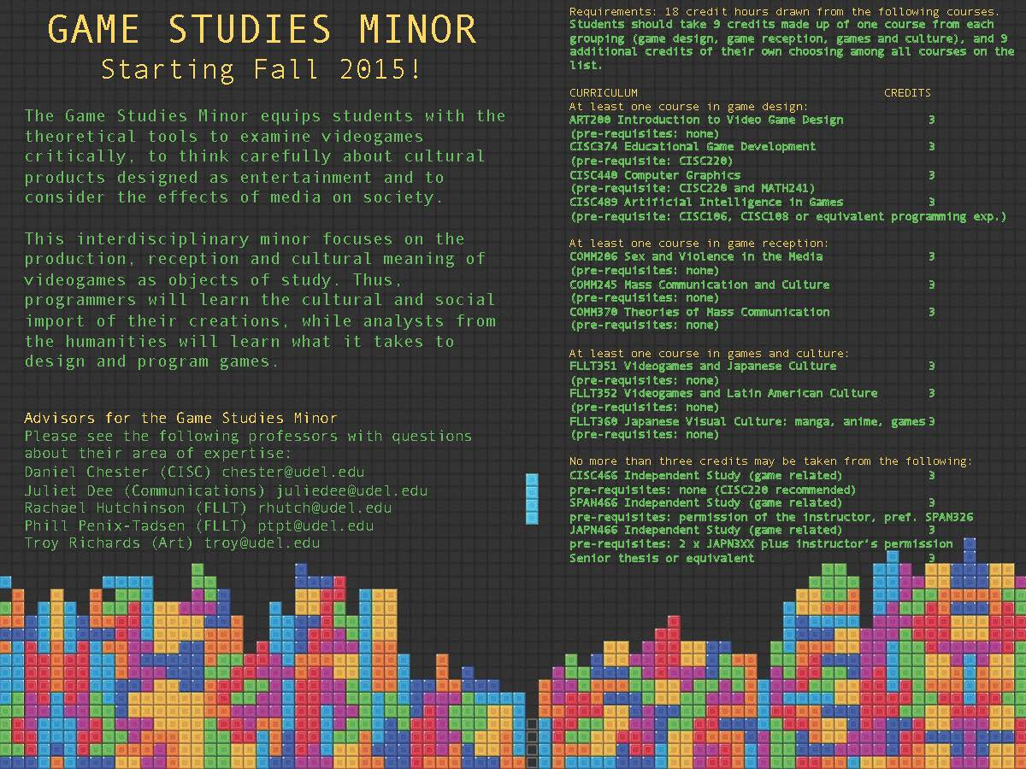

Slide 32
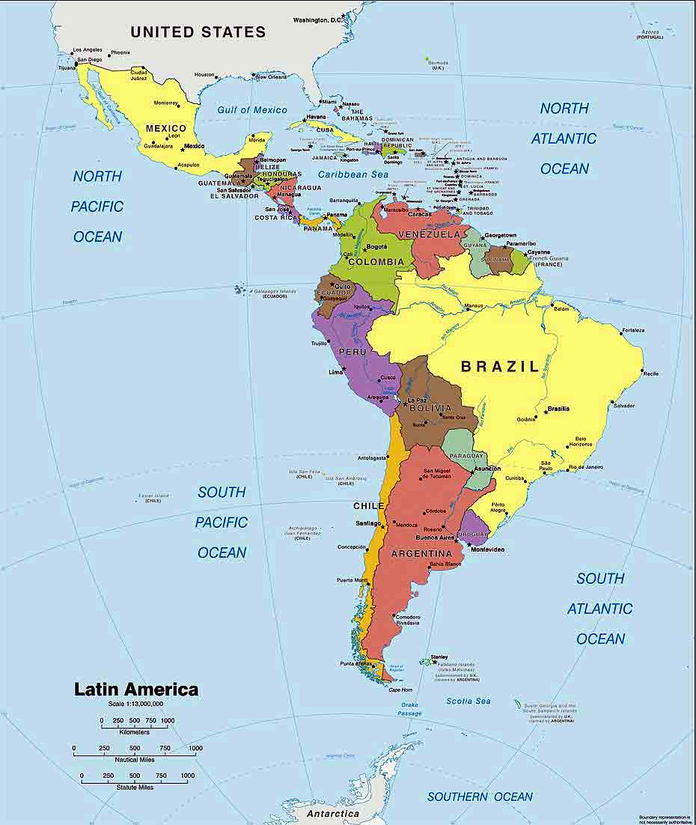

Slide 33
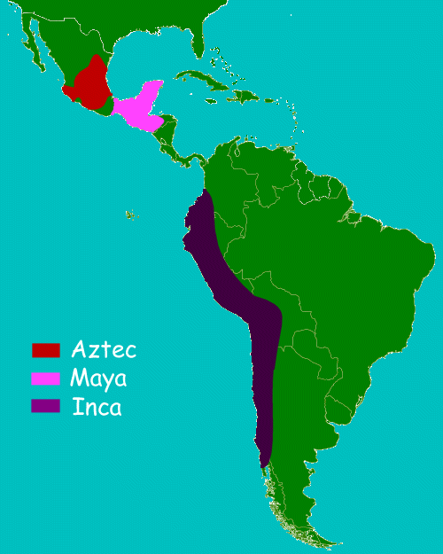

Slide 34


García Canclini starts out by saying that “Identity is a narrated construct.” (89) Can you think of an example of how video games construct or narrate cultural identity?
How has globalization affected cultural identity, according to García Canclini? (90-94) Are video games part of “universal” global culture? Or can video games bring “local” culture back?
García Canclini argues, “The dissolution of national and regional identities is even greater in … information technologies … as well as expanding and highly profitable forms of entertainment (video, video games, etc.),” and therefore he calls for greater attention to these technologies’ “effects on the reconstitution of identities.” (95-96)
In what way(s) do you think video games affect your own (cultural) identity?
What relationships do you see between García Canclini and the other readings and video games we have studied in this course?
Néstor García Canclini
“Identities as a Multimedia Spectacle”
(Consumers and Citizens, 2001)

Slide 35
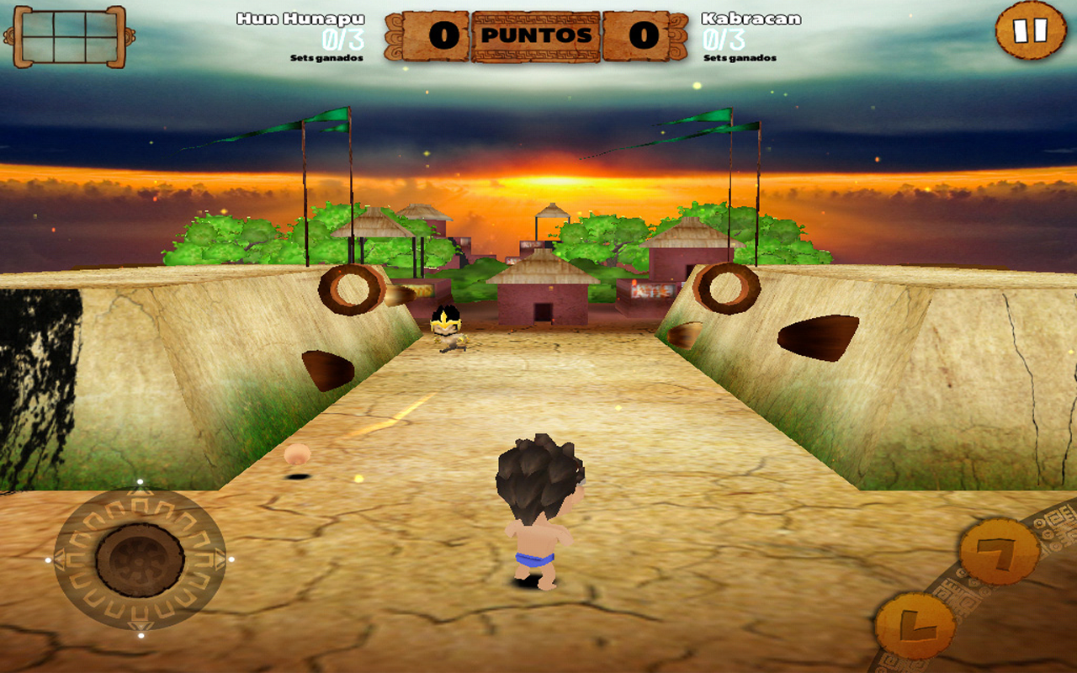
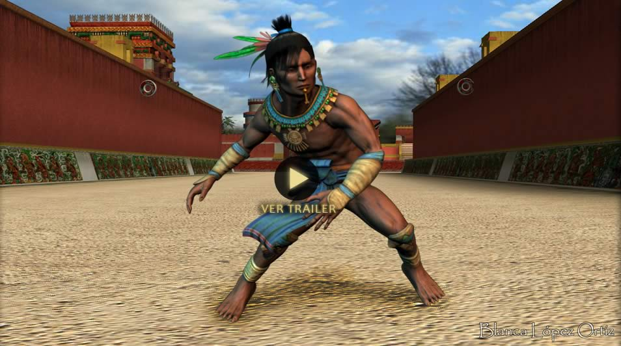
In what ways do Pok ta Pok and Mayan Pitz represent cultural identity?
Is cultural knowledge important in these games? Why or why not?
Which game is most effective in producing cultural context? Which game is most effective in creating an enjoyable gameplay experience? Why?
What connections do you see between these games and other course materials?
Notes:
Mayan Pitz (Calidá, 2013), adapts episodes from the Popol Vuh into the simplified format of a “casual” game
Mayan Pitz is an iPad, iPhone and iPod app aimed at a young audience, which was translated into the major Mayan dialects of Guatemala thanks to support from the country’s Ministry of Culture.
The second of these reimagined versions of the Mayan ball game is the highly ambitious Pok Ta Pok (Locomoción 3D, ), which incorporates a high degree of historical detail into its environments (including the mythical Xibalba as well as real-world ball court sites like Chichén Itzá, Palenque, Teotihuacán and Tenochtitlán), characters (a veritable pantheon of Mesoamerican gods including Tlaloc, Cuahtémoc and Xochitl) and indigenous cultures (not only the Maya, but the other ball-playing civilizations like the Aztecs, Olmecs, Zapotecs and Teotihuacanos).
<number>

Slide 37

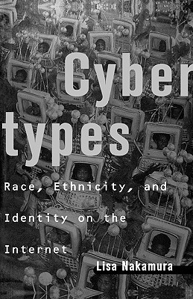
Share a definition, interpretation, or example that helps illustrate the terms introduced in Nakamura’s introduction to Cybertypes (2002):
cybertype (pp. 3-4)
authentic native (6, 19-20)
access (9, 27-28)
“outing” of race / gender online (11)
afterimage (11-12)
identity tourism (13-14)
monocultures (15-17)
cosmetic multiculturalism (21-22)
a “thing” for Asians (23-26)
digital divide and race (29-30)

Slide 38
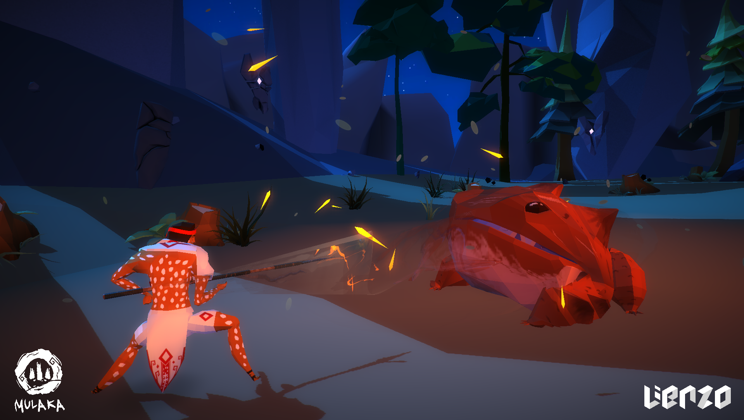
Lauren Woolbright
“Slow Violence in a Digital World: Tarahumara Apocalypse and Endogenous Meaning in Mulaka” (2019)
What does Mulaka have in common with other “indigenous games” or “World games”? (199, 214-215)
How does Mulaka use violence? How does this compare to other commercial and indie games made or set in Latin America? (202-205, 212-214)
Where does Lienzo stand with regard to the debate between universal appeal and local color? What is one way Mulaka incorporates elements of Tarahumara culture? (205-209)

Slide 39
Week 5: Hardware and Software Modification
Which game example did you find most interesting in this reading, and why?
Why do game designers choose to use elements of local culture in their products? Why do other game designers choose not to do so?
How does the present-day Latin American game industry differ from its historic roots?
What is the difference between “software modification” and “piracy”?
Phillip Penix-Tadsen Software Modification and Independent Game Design (from Cultural Code, 2016)

Slide 40
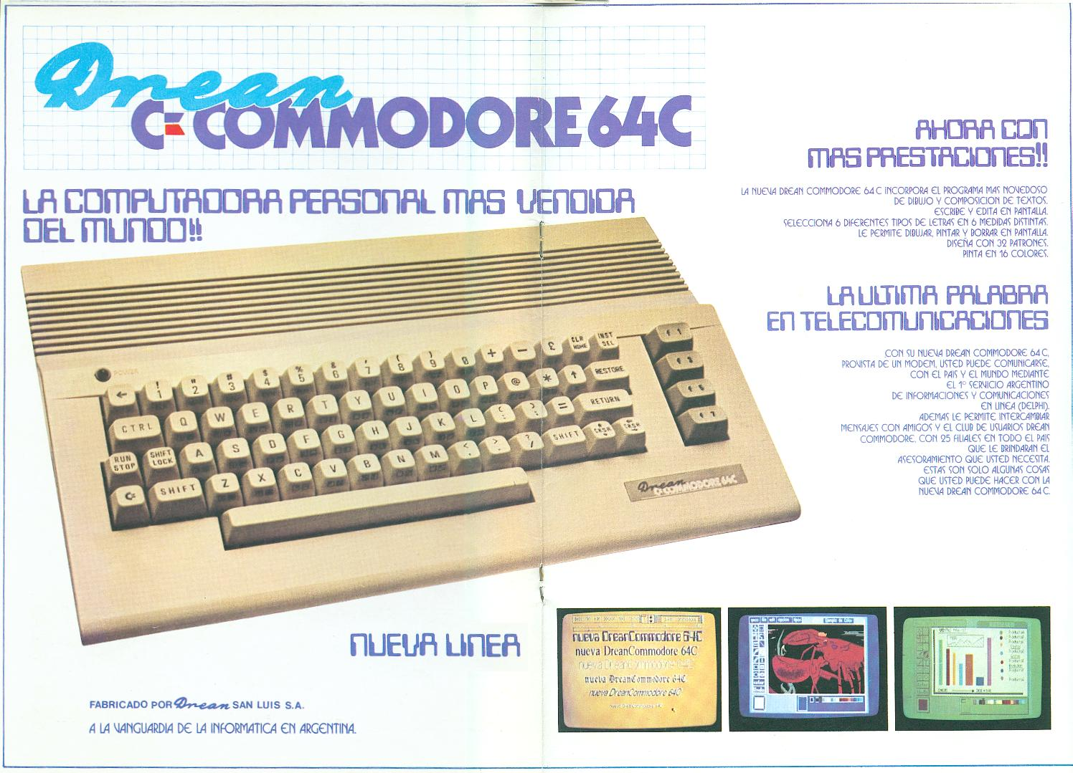

Slide 41
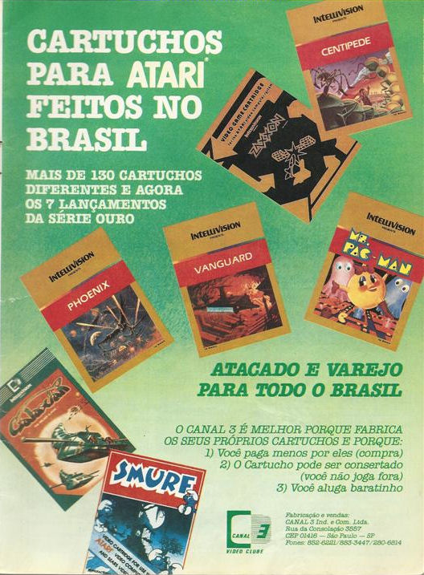

Slide 42
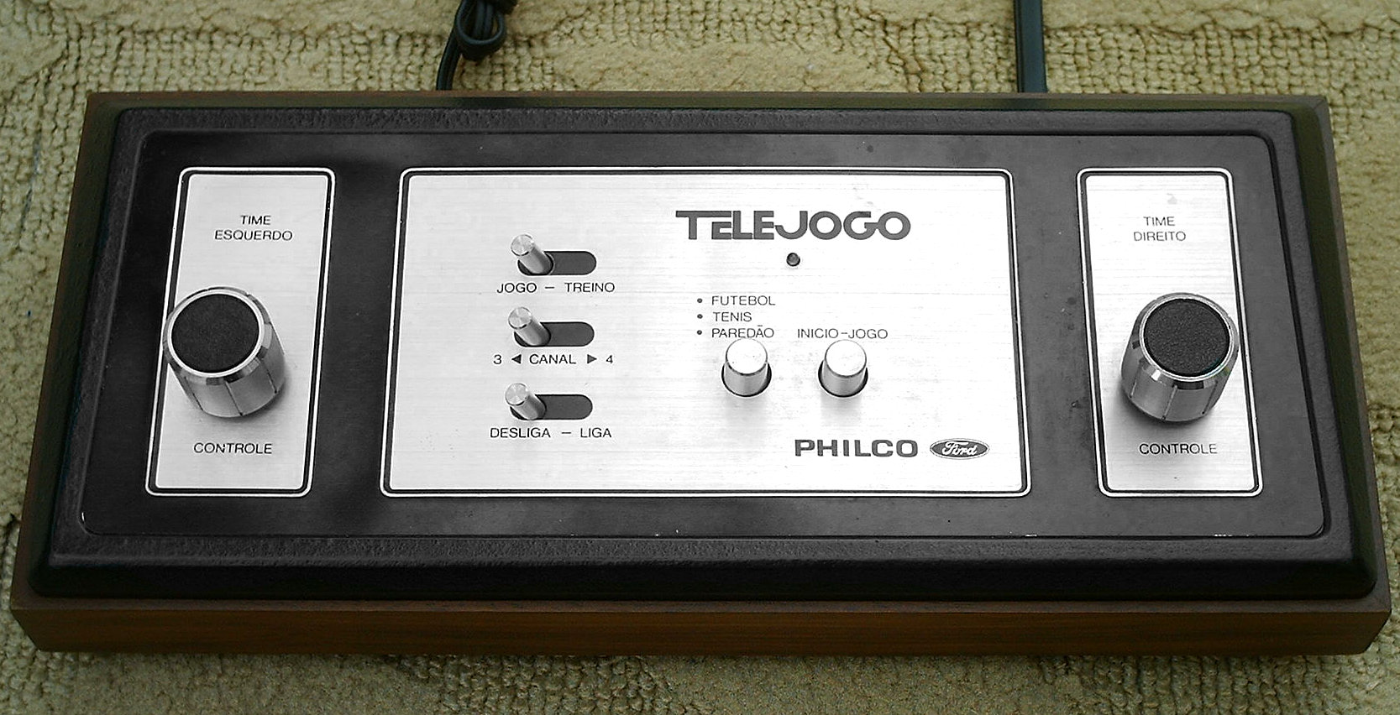

Slide 43
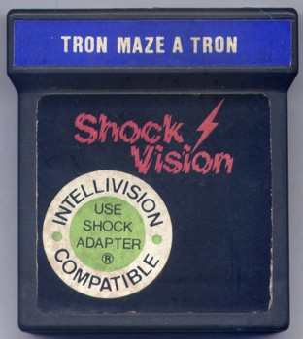
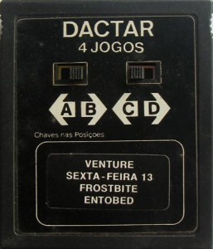

Slide 44
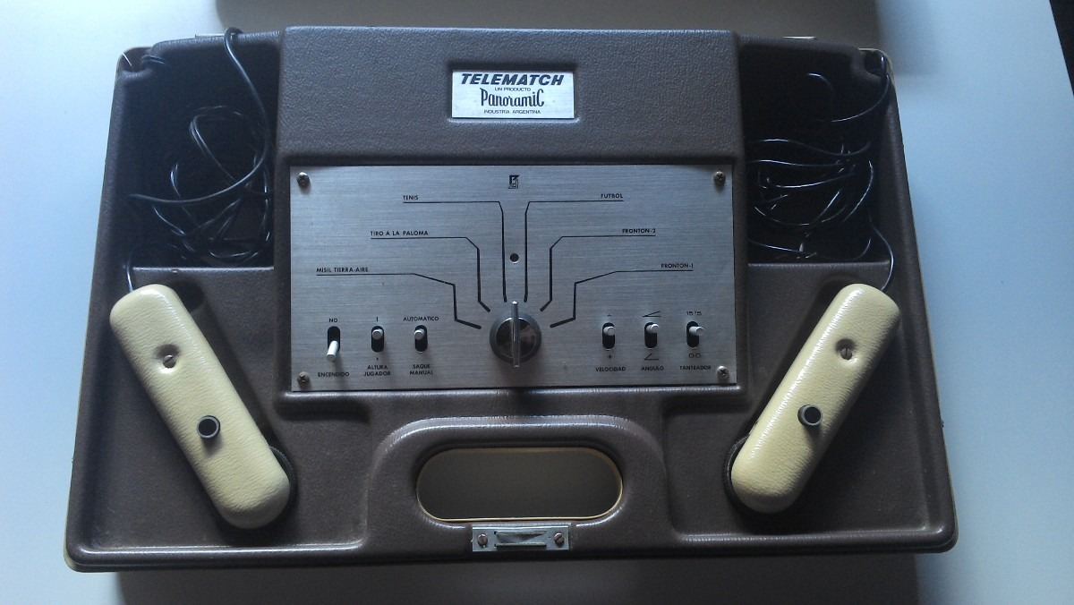

Slide 45
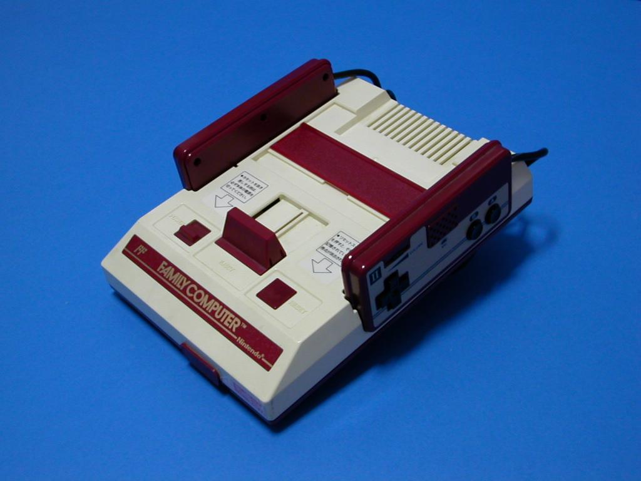

Slide 46
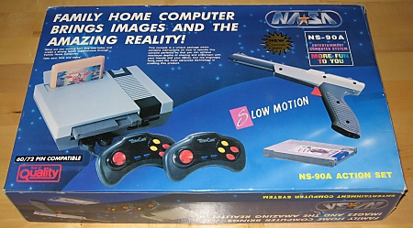

Slide 47
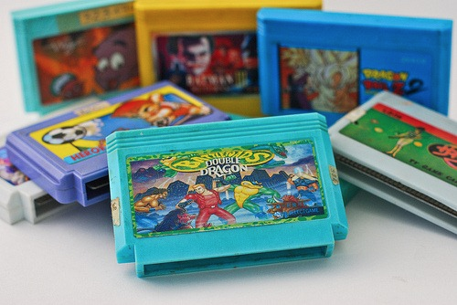

Slide 48


Slide 49
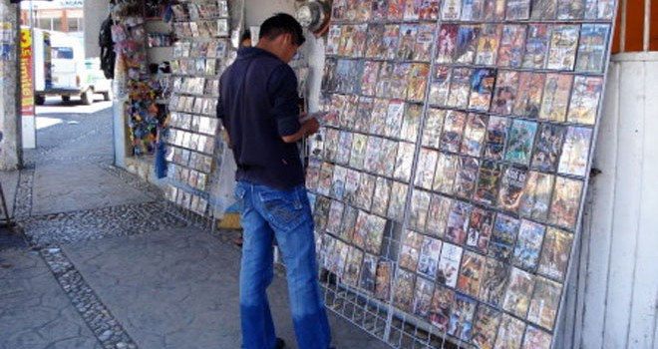
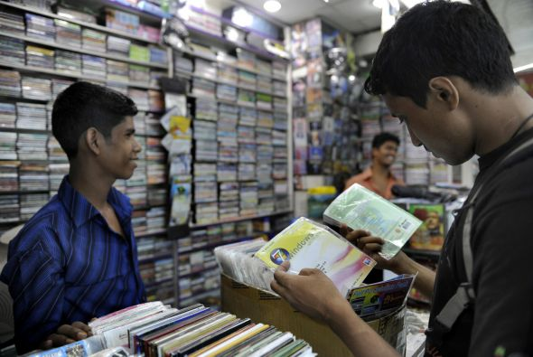
Objectives:
To broaden the discussion of new media in Latin America to under-examined cultural products such as computer software and video games
To demonstrate that the products of electronic media:
Are not merely transmitted unilaterally from the centers of technological production to the periphery, but through an asymmetrical process in which they are modified in significant ways to make them more meaningful and/or attractive to audiences in Latin America
Have historically been made accessible to a diverse audience spanning all socioeconomic strata and backgrounds beyond the scope of mainstream market data
To shift from economic and statutory definitions of “piracy” to a more inclusive definition of software modification, a practice:
That is frequently undertaken without concern for economic gain, and that can be mutually beneficial to modders and the software industry alike
Whose most significant impact in Latin America is not unlicensed financial gain through theft of intellectual property, but rather

Slide 50
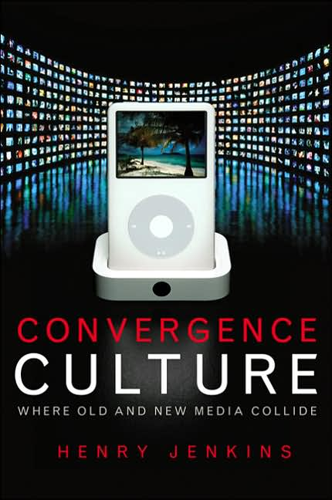
The story of American arts in the twenty-first century might be told in terms of the public reemergence of grassroots creativity as everyday people take advantage of new technologies that enable them to archive, annotate, appropriate, and recirculate media content.
[…] a thriving culture needs spaces where people can do bad art, get feedback, and get better. […] Much of it will be good enough to engage the interest of some modest public, to inspire someone else to create, to provide new content which, when polished through many hands, may turn into something more valuable down the line.
[…] much of what the public creates models itself after, exists in dialogue with, reacts to or against, and/or otherwise repurposes materials drawn from commercial culture. (137)
Henry Jenkins
Convergence Culture: Where Old and New Media Collide
New York University Press, 2006

Slide 51
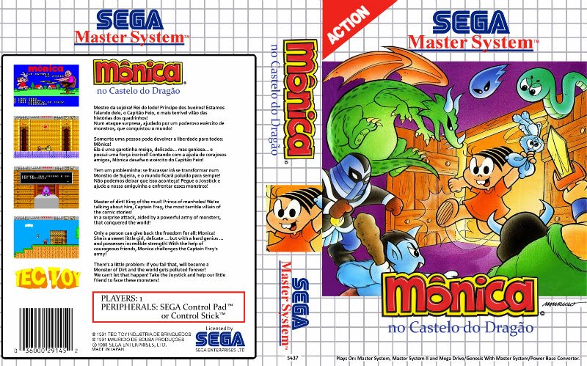
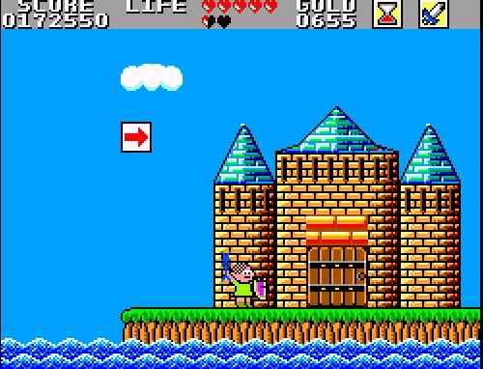
Mônica no Castelo do Dragão
(Monica in the Dragon’s Castle)
TecToy 1991

Slide 52
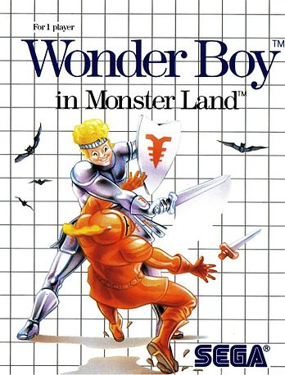
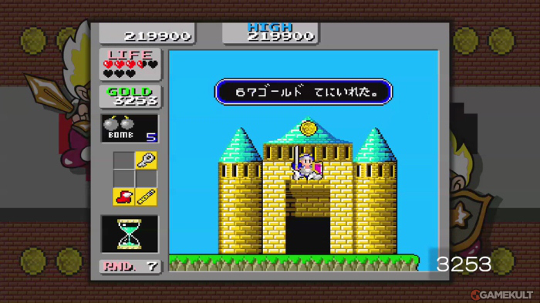
Wonder Boy in Monster Land
Sega 1988

Slide 53

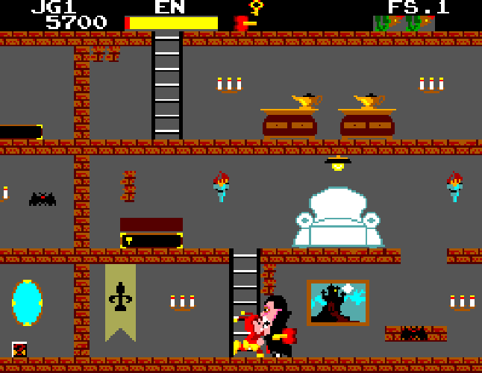
Chapolim x Dracula. Um Duelo Assustador (Chapulín vs. Dracula: A Frightening Duel)
TecToy 1989

Slide 54
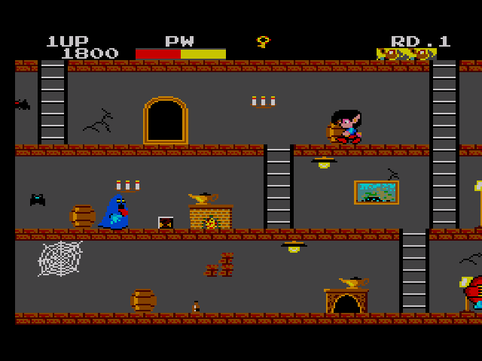
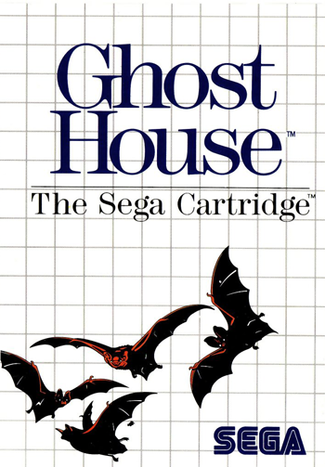
Ghost House
Sega 1986

Slide 55
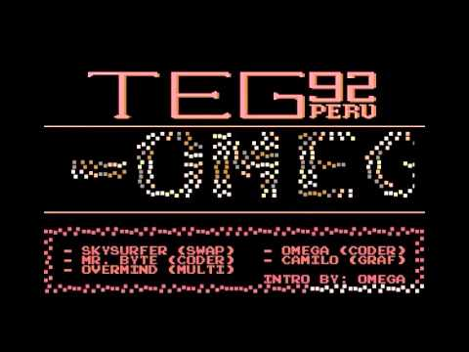
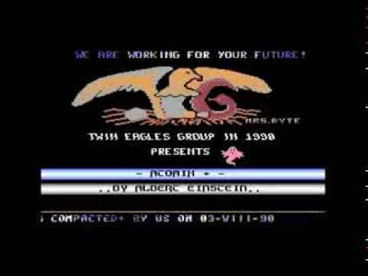


Slide 56

TEG’s King of Peru Development Team

Slide 57
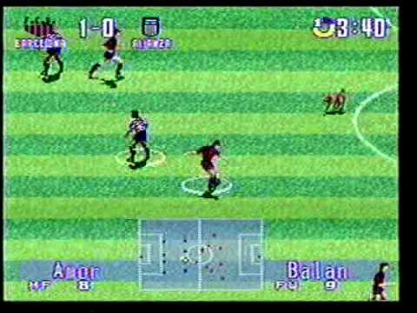
Fútbol Excitante (Exciting Soccer)
TEG 1997

Slide 58

Samba de Oruga (Caterpillar Samba)
TEG 2003

Slide 59


The King of Peru 2
TEG 2003

Slide 60

Modding: various ways of extending and altering officially released computer games, their graphics, sounds and characters, with custom-produced content.
Modding can also mean creating new game mechanics and new gameplay levels (maps) to the point where the original game transforms into a completely new title.
Modding Scene: collaborative networks for sharing modding resources (tools, programs, tutorials, FAQs and general help) and their creations (mods) with other enthusiasts. (12)
Modding is a social activity in which the player’s agency extends beyond an instantiation of the designer’s agency to the authorship of a new artifact. (13)
Modding does not only concern the code or the functions of a particular game, but the cultural instrumentalities of modding must be analyzed within the larger technological, economic and political contexts as well. (15)
Tanja Sihvonen
Players Unleashed!
Amsterdam University Press, 2011

Slide 61

MVP Caribe
MVP Baseball 2005 Modding Community 2007

Slide 62

MVP Caribe
MVP Baseball 2005 Modding Community 2007

Slide 63

What is at stake is the possibility of theorizing, and then implementing, what we could call a counterconsumptive, negative instance within cultural consumption itself; that is, the preservation of a sort of residual subject sovereignty or local singularity within the totalizing process of consumption. By counterconsumption I do not mean anticonsumption: it is not a matter of opposing mass-cultural consumption, precisely because we are always already immersed in it. Rather, counterconsumption refers to a particular mode of relation to consumption from within consumption […] (64)
Alberto Moreiras
The Exhaustion of Difference
Duke University Press, 2001

Slide 64


Flappy Quetzal
Carlos Villagrán 2014

Slide 65

NicaBird
Ninfusds Estudio 2014

Slide 66
Week 5: Hardware and Software Modification
Which game example did you find most interesting in this reading, and why?
Why do game designers choose to use elements of local culture in their products? Why do other game designers choose not to do so?
How does the present-day Latin American game industry differ from its historic roots?
What is the difference between “software modification” and “piracy”?
Phillip Penix-Tadsen Software Modification and Independent Game Design (from Cultural Code, 2016)

Slide 67

The Latin American Game Market
Demographics
$2 billion / year regional game industry
15 million (console) gamers in the largest national market, Mexico
target market: males 14-35
secondary markets: women 18-30 and men over 35
Localization
Games like Pro Evolution Soccer are customized to include well-known Mexican and Brazilian commentators, players, teams, and trophy races; PES13 sold 1 million copies in 5 days
Changes in production and consumption
Brazil manufactures the Xbox, PlayStation, and iPhone for domestic and regional consumption
80% of the population of Brazil will have internet access by 2016
300 small-to medium game design firms in Latin America

Slide 68


